Slide 1
Bored games
Yang Chen · Adrian Coffey · Cristiano Gaudino
Paul Gunnarsson · William Orr · Michael Smith

Slide 2
Contents
Website
Hangman
Backend
Topdown

Slide 3
Website

Slide 4
Hangman

Slide 5
Backend

Slide 6

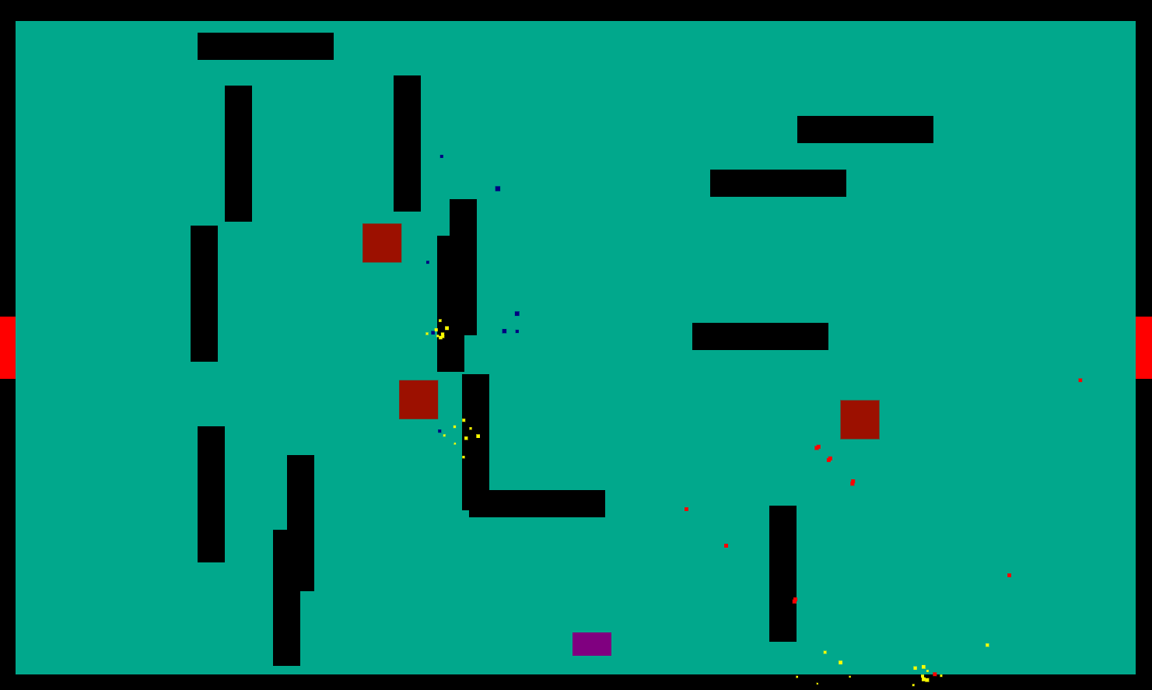
Topdown

Slide 7

An introduction to henry

Slide 9
Henry's pathing

Slide 11
Boss battle

Slide 12
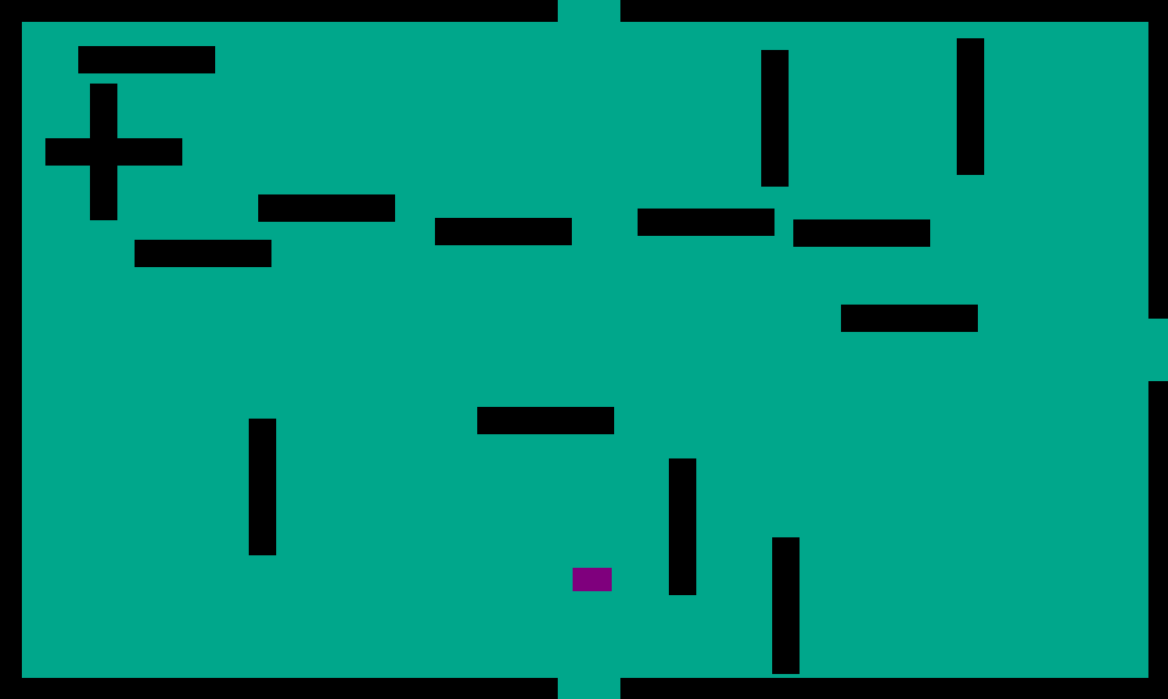
Room generation
Each time the game is reloaded, the map has changed
Rooms may branch out
The types of henry’s will start to vary more

Slide 13
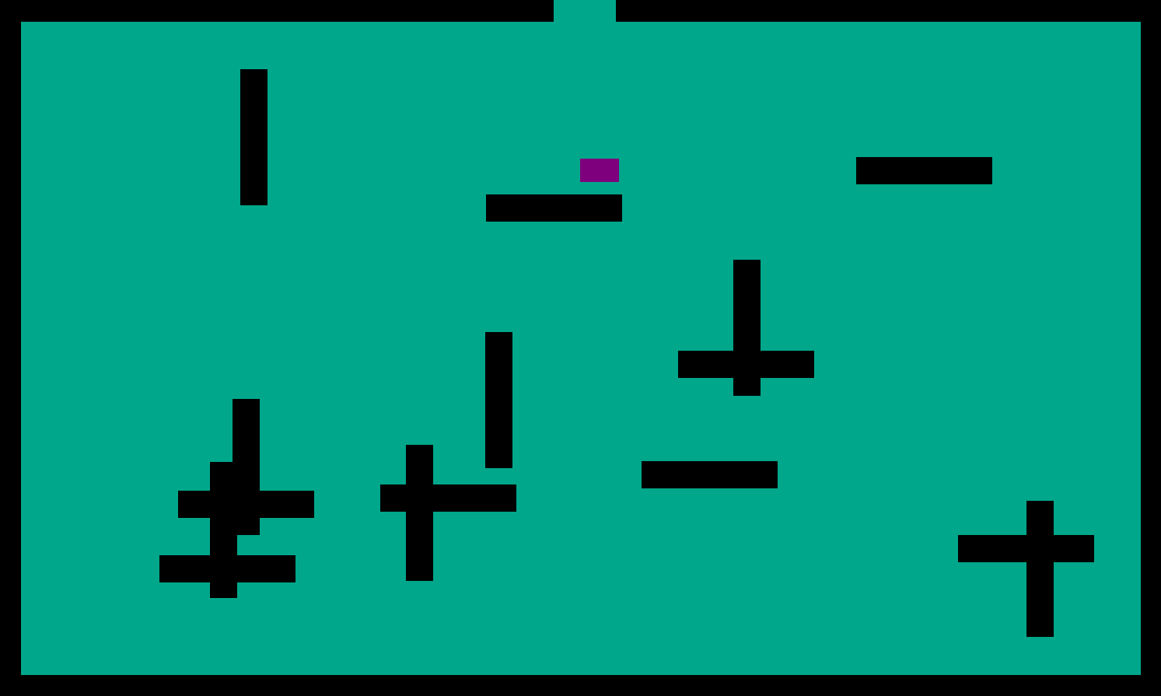
Each room also has its own random features

Slide 14
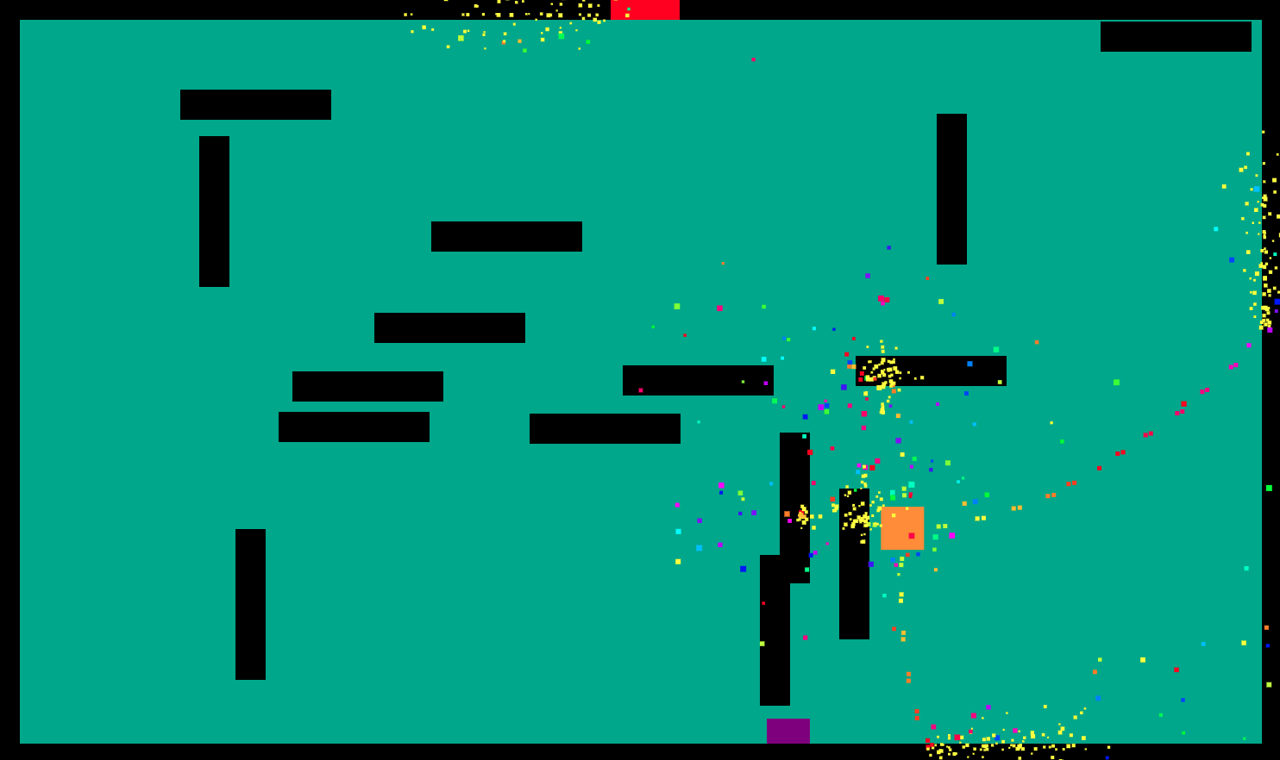
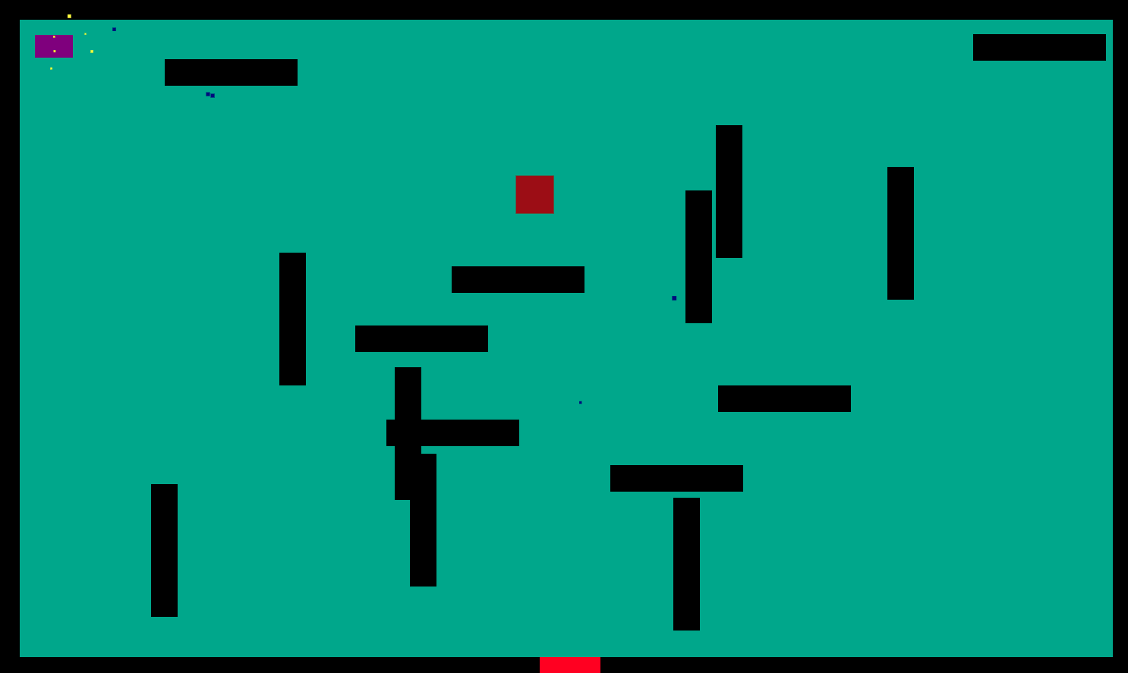
The player is locked in a room until all henrys are destroyed
Stephen will always spawn in the final room
The player wins by destroying all henrys in the map

Slide 15
The movement of the player
We Use WASD to control the forward, backward left and right

Slide 16
Player shooting
Firstly, We set the spacebar to shoot and the direction of the bullet is forward.
But it is too difficult to win.
So we changed the shooting method to use the mouse to control the shooting direction, and click to achieve shooting

Slide 17
The health pack
when you are low on health, it will appear. You can use it to add your health value. It will only appear two times.

Slide 18
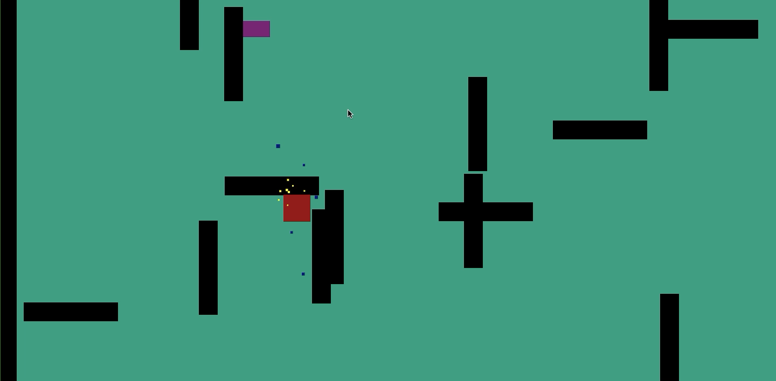
Winning the game
After you passed all the levels you will be congratulated

